Slide 1

3
Harmeet Singh Sehra

Slide 2
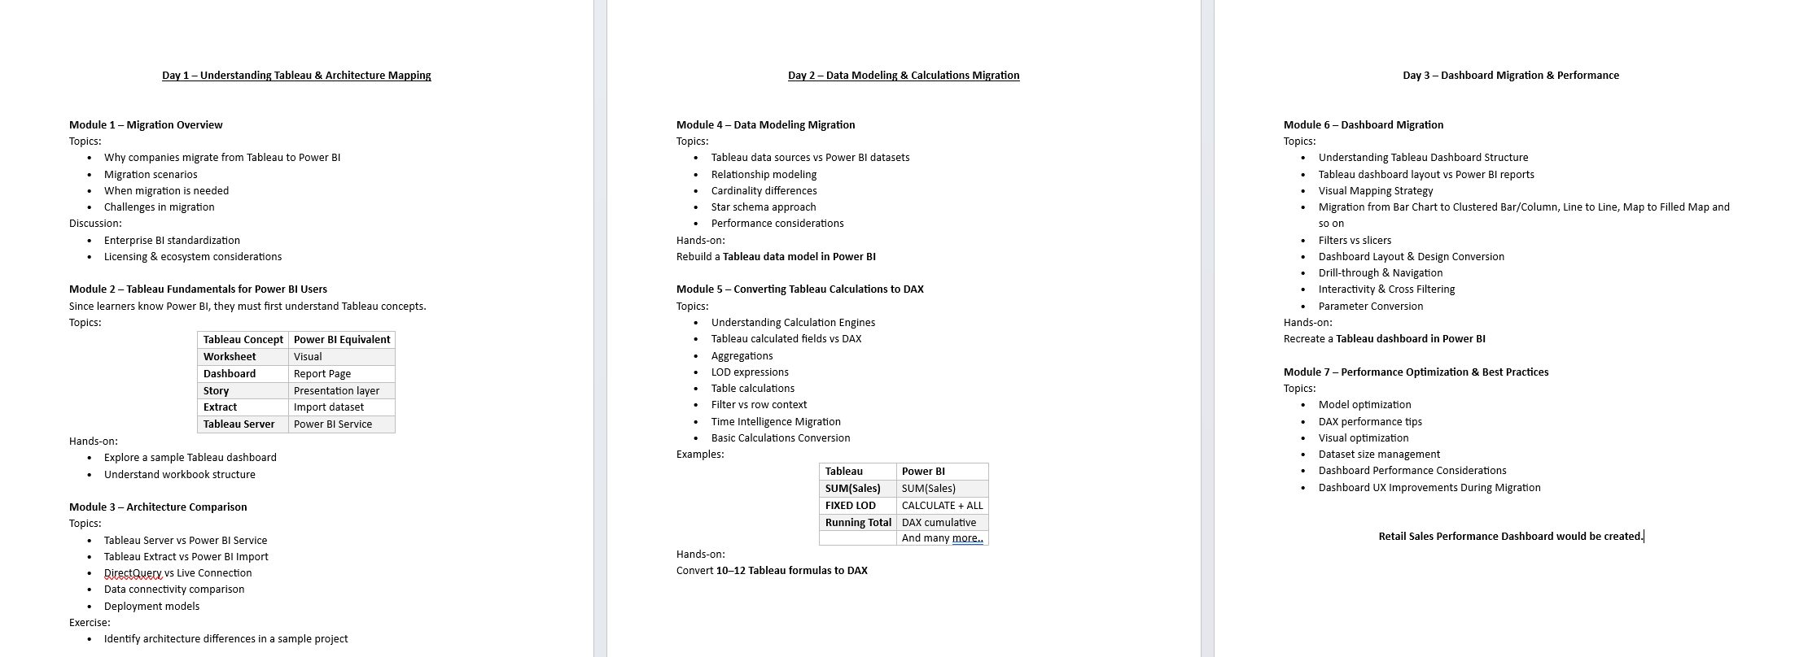
Table of Content

Slide 3
Recap-Day02
Data Modeling Migration
Tableau Data Sources vs Power BI Datasets
Relationship Modeling and Cardinality Differences
Star Schema Approach
Retail Sales Analysis in Tableau: Visualisation, Marks Shelf, Column/Row
Understanding Calculation Engines
Tableau Calculated Fields vs DAX
Aggregations: Sum , Count
LOD(Level of Detail) Expressions-FIXED,INCLUDE
Table Calculations - RUNNING_SUM
Filter Context vs Row Context

Slide 4
Day 03’s Agenda
Module 6 – Dashboard Migration
Topics:
Understanding Tableau Dashboard Structure
Tableau dashboard layout vs Power BI reports
Visual Mapping Strategy
Migration from Bar Chart to Clustered Bar/Column, Line to Line, Map to Filled Map and so on
Filters vs slicers
Dashboard Layout & Design Conversion
Drill-through & Navigation
Interactivity & Cross Filtering
Parameter Conversion
Module 7 – Performance Optimization & Best Practices
Topics:
Model optimization
DAX performance tips
Visual optimization
Dataset size management
Dashboard Performance Considerations
Dashboard UX Improvements During Migration

Slide 5
Understanding Tableau Dashboard Structure

Slide 6
A Tableau dashboard is a combination of multiple sheets (charts, tables, maps, etc.) arranged together with interactive elements like filters, parameters, and actions.
Sheets: Individual visualizations.
Filters: Control the data displayed across sheets.
Parameters: Dynamic input controls for user-driven changes.
Actions: Hover, select, or menu-driven interactivity.
Layouts: Floating vs tiled objects.

Slide 7
Tableau Dashboard Layout vs Power BI Reports

Slide 8
Feature | Tableau | Power BI
Layout | Tiled & Floating containers | Canvas-based, mostly free-form
Filters | Filter shelf, can be global or local | Slicers, visual-level, page-level, report-level
Actions | Filter Actions, URL Actions, Highlight Actions | Drill-through, cross-filter, bookmarks
Parameters | User-driven dynamic inputs | Parameters via “What-if” and field references
Containers | Horizontal & Vertical | Horizontal & Vertical containers (like Tableau)
Interactivity | Dashboard Actions, Highlighting | Cross-filtering, cross-highlighting, bookmarks, drill-through

Slide 9
Visual Mapping Strategy

Slide 10
When migrating charts, identify the best Power BI equivalent:
Tableau Chart | Power BI Equivalent
Bar Chart | Clustered Bar/Column
Line Chart | Line Chart
Area Chart | Area Chart
Map (Symbol) | Map or Filled Map
Pie Chart | Pie Chart / Donut Chart
Scatter Plot | Scatter Chart
KPI / Number | Card Visual
Text Table | Table / Matrix
Highlight Table | Conditional Formatting in Table/Matrix

Slide 11
Migration from Chart to Chart
Step-by-step for a bar chart example:
Identify the dimension and measure used in Tableau.
Open Power BI → insert Clustered Column Chart.
Drag the same dimension to Axis and measure to Values.
Apply sorting, formatting, and colors to match Tableau look.
Apply any filters/slicers associated in Tableau.

Slide 12
Activity
Business Requirement
Categorize each Region based on its contribution to total sales:
Leader Region → Contribution > 40%
Growing Region → Contribution between 20% and 40%
Low Contribution Region → Contribution < 20%

Slide 13
Filters vs Slicers

Slide 14
Tableau: Filters applied via filter shelf or dashboard actions.
Power BI: Slicers perform the same function.
Conversion Strategy:
Visual-level filter → Visual-level filter in Power BI.
Dashboard/global filter → Report-level slicer.
Continuous dates → Date slicer with relative, between, or list options.

Slide 15
Dashboard Layout & Design Conversion

Slide 16
Steps to convert layout:
Analyze Tableau’s dashboard grid (rows, columns, floating charts).
In Power BI, use Gridlines and Snap to Grid for alignment.
Use containers for grouping similar visuals.
Resize visuals to match Tableau proportions.
Add titles, images, and logos to mimic Tableau’s design.

Slide 17
Drill-through & Navigation
Tableau: Filter actions or sheet swapping for drill-through.
Power BI: Drill-through pages, bookmarks, or buttons. Step:
Identify the target sheet in Tableau (destination of drill-through).
In Power BI, create a drill-through page with the same dimension in “Drill-through filters.”
Add a button or right-click navigation to enable drill-through.

Slide 18
Interactivity & Cross Filtering

Slide 19
Tableau uses highlight actions and filter actions.
Power BI provides:
Cross-filtering / cross-highlighting between visuals.
Sync slicers across pages.
Conversion tip: replicate Tableau’s filter actions by selecting Edit interactions in Power BI for each visual.

Slide 20
Parameter Conversion

Slide 21
Tableau parameters allow dynamic values (e.g., Top N, Thresholds).
Power BI supports:
What-if parameters for numeric inputs.
Use calculated measures to replicate parameter-driven logic. Example:
Tableau: Parameter “Top N Customers” → Filter top N.
Power BI: Create a numeric “What-if” parameter and use RANKX() in DAX to filter top N customers dynamically.

Slide 22
Best Practices for Dashboard Migration

Slide 23
Document all Tableau visuals before starting migration (dimension, measure, filters, actions).
Start with simple charts → then complex dashboards.
Validate measures by comparing totals and KPIs.
Maintain colors and branding for consistency.
Test interactivity (filters, slicers, drill-through) after migration.
Use containers in Power BI to group related visuals like Tableau’s layout.

Slide 25
Performance Optimization & Best Practices

Slide 26
Model Optimization
Goal: Make your data model efficient for faster calculations and responsive dashboards.
Best Practices:
Star Schema Design: Keep a fact table with measures and dimension tables with attributes.
Avoid Bi-Directional Relationships unless necessary; use single-direction relationships to reduce calculation complexity.
Use Lookup Tables: Separate dimension tables reduce duplication and improve DAX performance.
Remove Unnecessary Columns: Only load columns used in calculations, visuals, or filters.
Data Types: Use correct data types (integer instead of decimal when possible) to reduce memory usage.

Slide 27
Total Profit Calc = SUMX(Sales, Sales[Sales] * 0.1)
Electronics Sales = SUMX( FILTER(Sales, Sales[ProductCategory] = "Electronics"), Sales[Sales] )

Slide 28
DAX Performance Tips
Efficient Calculations:
Prefer CALCULATE + FILTER over complex row-by-row operations.
Use SUMX / AVERAGEX sparingly; aggregate in the fact table if possible.
Avoid iterators on large tables.
Use variables (VAR) to store intermediate results and reduce repeated calculations.
Minimize the use of ALL() or REMOVEFILTERS() on large tables unless needed.

Slide 29
Visual Optimization
Reduce the number of visuals per page – each visual adds query overhead.
Avoid complex visuals (like high-cardinality scatter plots) unless necessary.
Limit data points in charts; use aggregated measures instead of raw records.
Use slicers efficiently: Avoid multiple slicers on high-cardinality columns.
Use conditional formatting and KPIs carefully, as they can slow rendering.

Slide 30
Dataset Size Management

Slide 31
Dataset Size Management
Points to be remembered:
Remove unnecessary columns and tables.
Filter data at the source (SQL query / Power Query) before loading.
Use summary tables for historical data rather than storing all transactions.
Enable data type compression in Power BI (integer, fixed decimal, etc.).
Partition large tables for incremental refresh.

Slide 32
Dashboard Performance Considerations

Slide 33
Page Design:
Avoid too many visuals on a single page.
Keep top-level KPIs lightweight for quick loading.
Filters and Slicers:
Use hierarchy filters instead of multiple independent slicers.
Avoid excessive cross-filtering in complex dashboards.
Incremental Loading:
For large datasets, enable incremental refresh to improve load times.
Query Reduction:
Disable auto date/time if not needed.
Use aggregated tables instead of querying raw transaction tables.

Slide 34
Dashboard UX Improvements During Migration
Consistency: Match Tableau dashboard look with Power BI for a smooth user experience.
Navigation: Use buttons, bookmarks, and drill-through instead of multiple complex filter actions.
Responsiveness: Optimize visuals and slicers for faster interaction.
Color & Layout: Use a clean, consistent layout for clarity.
Tooltips & Interactivity: Use enhanced tooltips instead of extra visuals to reduce clutter.
Page Load Time: Keep the first page lightweight for faster opening; heavy calculations can be deferred to secondary pages.

